Slide 1
Topics covered
Overview of Redmond’s 401(k) plan
Types of contributions (ROTH or Traditional)
How to register your account (see video)
How to adjust your contributions and investments (see video)

Slide 2
Summary of Redmond’s 401(k) Plan
Operated by Empower Financial Services
All associates are automatically enrolled after 6 months
Default: 4% into the ROTH option & target fund
Automatic 1% annual increase until 8%
Redmond contributes about half of your contribution up to 4%
Redmond’s contribution is to a Traditional option
Redmond’s contribution has a vesting period

Slide 3
(Summary continued)
Contributions don’t start for 6 months, but you can register and log in within one month of your start date
You can consolidate (rollover) a 401(k) from a previous employer into your Redmond 401(k) after you register your account
You can change the defaults after you register and before contributions start

Slide 4
Say “Yes!” To Free Money
If you’re not contributing at least 8% of your paycheck, you’re saying no to money that Redmond wants to give you.
Redmond contributes about half of what you contribute up to 4%
If you only contribute 4%, Redmond will contribute 2.5%
If you contribute 8% or more, Redmond will contribute 4%

Slide 5
Example: Associate Earning $2,000 Biweekly
Contribution Percentage | Associate Contribution | Redmond Contribution
3.0% | $60 | $40
4.0% | $80 | $50
5.0% | $100 | $60
6.0% | $120 | $70
7.0% | $140 | $75
8.0% | $160 | $80
10.0% | $200 | $80
Your contribution is 100% yours no matter how long you stay with Redmond
Redmond’s contribution is subject to “vesting” and isn’t 100% yours until you’ve been an employee for the entire vesting period

Slide 6
ROTH Versus Traditional
ROTH is post-tax--You pay the full tax amount today and the money grows tax free, which means that when you are old enough to withdraw it, you won’t pay tax on the growth, whether from interest, dividends, investment returns, etc.
Traditional is pre-tax--The amount you contribute is subtracted from your W-2 wages before your income tax is calculated. That reduces how much you owe in taxes today, but when you retire and withdraw the money the IRS will tax whatever you take out—your initial contribution as well as any interest, investment gains, etc.
Which is better? Experts disagree and it depends on your situation. In general, the ROTH option is better when you’re younger or in a lower tax bracket, but even that depends on what your goals are. Research the options or talk to an advisor to learn what’s best for your situation.

Slide 7
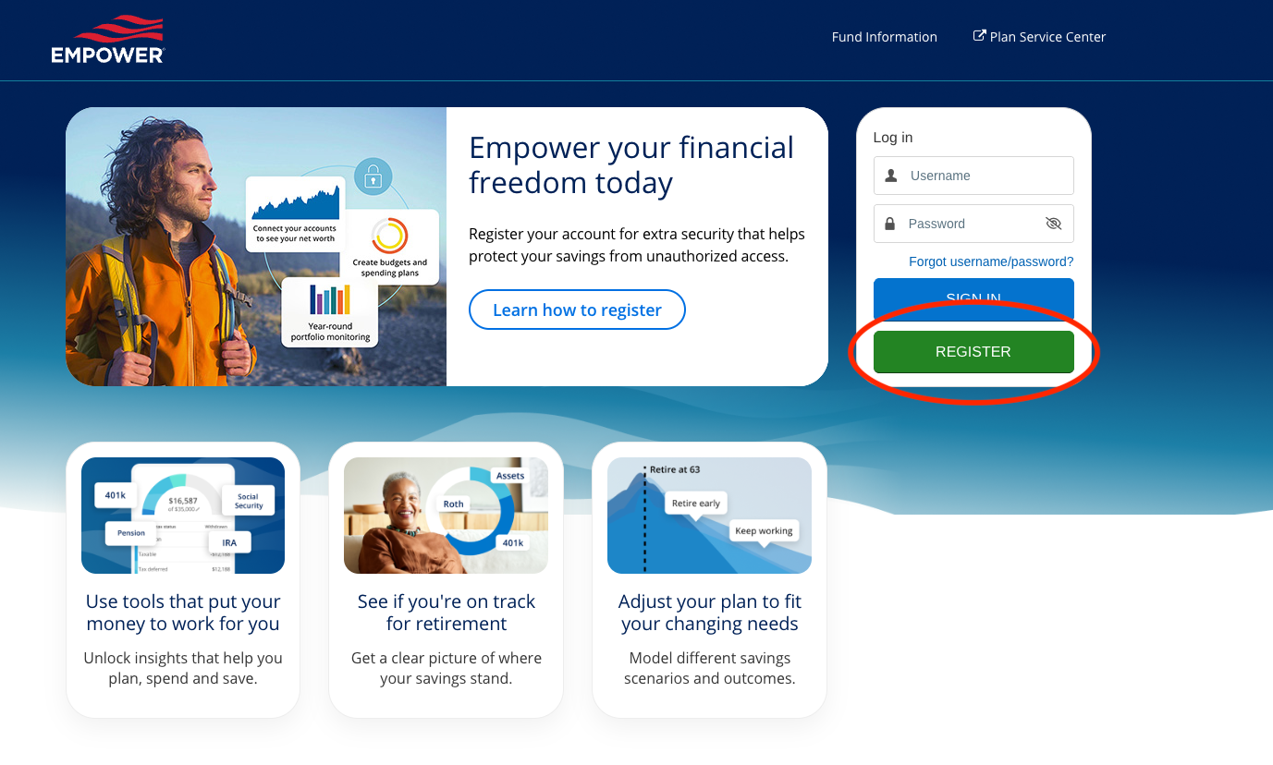
How to Register and Log In
https://participant.empower-retirement.com/

